Slide 1
Smerge: Smarter Merge
Conflict Resolutions
Alva Wei (alvawei) Jediah Conachan (jediah6)
Kenji Nicholson (kenjilee)
Steven Miller (stevenm62)
Sungmin Rhee (srhee4)

Slide 2
Feedback (see notes)
Notes:
Overall, I think this presentation wasn't focused on the important parts of your project. You spent a lot of time on small details but failed to fill in the big picture for the audience. The next time you present, you should focus more on the high-level vision, the motivation, and how your work relates to that of others. Even when speaking to a familiar audience, avoid meta comments like "in case you don't remember". These are distracting and waste time, and don't add any content. You disparaged conflerge as being limited to a single language, but your project has the same limitation. You also didn't address the only real limitation of conflerge you identified, which was the whitespace issue. Does your tool have the same problem? More generally, I wasn't convinced that you were doing anything other than reimplementing conflerge for python. If that's what you're doing, just say so. Don't try to mislead the audience. You listed supporting multiple languages as a goal, but didn't ever address how you might achieve it. Your "approach and implementation" slide has too much text that is too small. I'd advise you to make the diagram larger and actually explain it, and then animate in what's currently in the black box. Parsing is a solved problem. Why isn't your parsing slide "we used the following library to parse python ASTs" and then the name of a library? You did not explain parent and child matching, nor why you have not implemented it. The audience has no idea if it is important. Is the "matching" algorithm different than conflerge's? Don't bother to include move - decompose down to basic operations. If you do mention move, suggest that it's just syntactic sugar instead of presenting it as a primitive. There is no need to explain in excruciating detail what false positives, true positives, etc. are. That entire slide could have been cut down to a few sentences of audio - the audience knows these terms. Your second metrics slide was much more interesting, but you spent much less time on it. Your initial results are not good, but I think you know this. How did conflerge do? That could be a useful baseline, even on totally different projects. You should have spent some of your time discussing *why* your tool was currently failing. The audience was left with the impression that you have just failed - you don't want that impression. Instead, try to show that you are working on solving the problem! Maybe the audience can even suggest ways to help. Your biggest risk is that your tool doesn't work right now.
Martin J Kellogg , May 16 at 7:12pm
Your discussion of related work needs significant improvement. Losing comments seems like a much bigger deal than whitespace, but you mentioned the latter on the slide and the former only verbally. You suggested that kdiff is part of git, but it's not. Perhaps you are confused about the architecture of the tools. There is lots more related work that you can cite. (Start with what is in the Conflerge report, but don't stop there.) When discussing related work, don't just say what the other work does. Explicitly compare and contrast it with yours. On the goals slide, you said that your tool "sits between the user and git". How? This is not clear from a user perspective or an implementation perspective. Don't use terms like "trivial merge" without defining them. More generally, this slide is too vague. You discussed parsing at length. What is interesting about that? If it's standard, you don't need to belabor it. You didn't say whether you implemented your own (that was implied), but that would be a very bad use of your resources. On the matching slide, what is the relationship between "unique ID" and "label"? In the human resolution, what if the human did extra work while merging (like noticing a typo and fixing it)? Then that might be a bad goal for an automated tool. Discuss this issue. The first "Metrics" slide was better in that it finally adopted a reasonable methodology as I have told you numerous times. However, then you revealed that it was a tease and you aren't doing that after all. Your excuse that this would require human work is weak. You need to do the work. This is really easy to do given that you are only running your tool on 70 conflicts now. It is not acceptable to abandon a correct methodology and choose a bad one just because the bad one is slightly easier. The second methodology (which you should not use!) isn't even defined; what does "possibly undesired behavior" mean? I was surprised that analyzing cases where the tool fails to merge is future work; I would have expected you to do that for this presentation.
Michael D Ernst , May 18 at 10:53am
Overall very good presentation. At a first glance, I like the format of the slides. The colors are easy to look at and the font goes along well with it. I like how the team aimed to put more pictures and tables in the slide. It helps the audience better understand the problem rather than looking a giant blob of text. Your text sections are bulleted which again help the audience better understand. No one wants to read a essay during a presentation. Going into the final presentation, I suggest: Get a final demo working. Talking about the usage of your product vs other products. Ease of usage. Accuracy ect. Maybe some final thoughts to leave the reader. Advertise, where can I find this product. Will it be useful in future development and is it easy to integrate into the overall workflow. Great job and I hope you the best of luck in the rest of the quarter!
Anonymous User , May 30 at 10:48am

Slide 3
Motivation
Version control systems (VCSs) use line-based analysis to detect merge conflicts
Unable to automatically resolve many merge conflicts, so developers have to resolve them manually
Git (most popular VCS)
Capable of merging whitespace conflicts
Conservative to prevent undesired merges
Git mergetools
All-in-one merge solutions: GUI, code editor, automatic merge facility
Manual merges = valuable developer time = more $$$ spent on projects
Goal: Reduce the number of conflicts presented to the users
Automatically handle as many merge conflicts as possible
Notes:
Should we include any examples here? His feedback said to include a real world example, but we’re doing that later in the demo, right? It could use one but I’m undecided..
I think it might be a good idea to show the example here to help motivate the problem and then run through it during the demo to show that our tool solves it

Slide 4
Merge Conflict Example
1 # Common Ancestor (Base):
2 for batch_index in range(0, nb_batch): 3 batch_start = batch_index*batch_size 4 batch_end = min(len(X), (batch_index+1)*batch_size) 5 batch_ids = index_array[batch_start:batch_end]
Example from: Keras: Deep Learning for humans - https://github.com/keras-team/keras
Notes:
Mention that this example is from the keras repository

Slide 5
Merge Conflict Example (cont.)
1 # Theirs (Remote): 2 for batch_index, (batch_start, batch_end) in enumerate(batches): 3 batch_start = batch_index*batch_size 4 batch_end = min(len(X), (batch_index+1)*batch_size) 5 batch_ids = index_array[batch_start:batch_end]
1 # Yours (Local): 2 for batch_index in range(0, nb_batch): 3 batch_start = batch_index*batch_size 4 batch_end = min(len(X), (batch_index+1)*batch_size) 5 if shuffle: 6 batch_ids = index_array[batch_start:batch_end] 7 else: 8 batch_ids = slice(batch_start, batch_end)
Example from: Keras: Deep Learning for humans - https://github.com/keras-team/keras
Notes:
Red portions = respective changes made
This shouldn’t be a conflict, ideal solution would be to keep both of the changes that both developers made during the merge

Slide 6
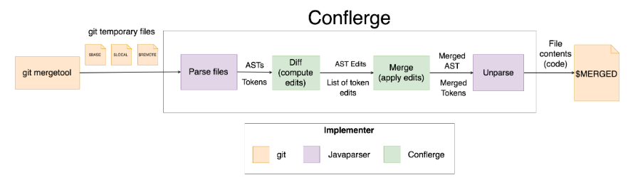
Current Approaches: Conflerge
Uses abstract syntax tree (AST) merging to automatically resolve conflicts
Dependency on JavaParser means only compatible with Java
JavaParser, however, guarantees an AST represents valid Java code
Discards custom whitespace placed by contributors
https://github.com/ishansaksena/Conflerge
Notes:
Conflerge is a git merge tool that is used for java projects. It is basically a wrapper around Javaparser, which produces ASTs out of source code. Conflerge takes these ASTs and runs a merging algorithm on them. Some of the downsides are:
The result of a merge is all formatted according to the default Javaparser formatting -- any custom whitespace for example is not preserved. This is a problem since many developers use whitespace for code clarity purposes. This means that the developer must manually reinsert it and commit the code again.
Since Conflerge uses Javaparser, languages other than java are not supported.
When there is a failure to merge (tool couldn’t resolve the merge conflict), give example of a failure and show the output on the side? (in the last presentation, we said that no information was given to the user-- which is what I thought according to what the contributor to conflerge told me, but Bryan said he got a lot of exceptions he didn’t understand. If we can reproduce this it might be a good idea to include it, or just give screenshots of whatever failures we get and talk about those.)
Incl. example of simple merge that git can handle, but an example of one it cannot solve.

Slide 7
Our Approach
Centered on a language independent AST
Our AST provides the following benefits:
Specialized for merging algorithms (don’t have to work around other existing AST formats)
Merging algorithms also become language independent
Retaining source code for unparsing the final merged tree
Allows for whitespace conservation
Control and flexibility
Notes:
Define generic ast

Slide 8
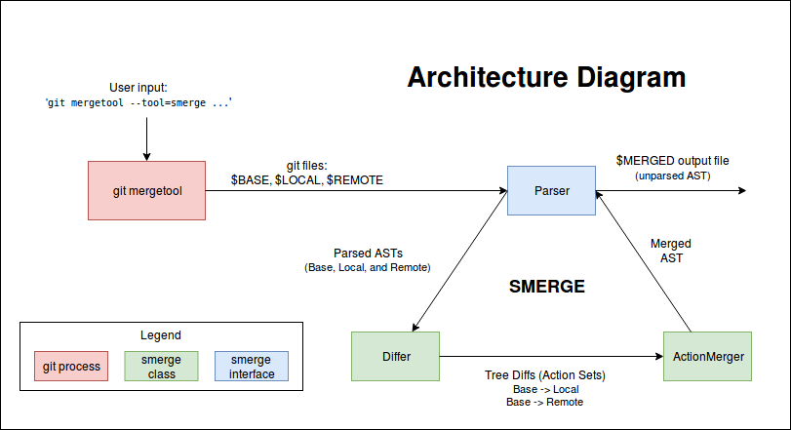
High Level Operations
Similar to Conflerge’s, but completely different on the inside.

Slide 9
Parsing
Must parse source code files into our generic AST
Requires a separate Parser for each language
Each parser must implement our Parser interface
Requires methods for parsing and unparsing
We implemented our own simple Python Parser
Base, local, and remote files are parsed line-by-line into our generic AST
AST nodes store type, content, indentation, and an ID (for matching)
If a language requires more complex nodes, these nodes can be easily extended

Slide 10
Merging Process
Input: BASE, LOCAL, REMOTE ASTs
Compute tree diffs BASE→LOCAL and BASE→REMOTE
First, match the nodes between all three trees
Second, detect differences between BASE and LOCAL, and BASE and REMOTE
Tree diffs are represented as a set of actions (insert, delete, update a node)
Merge and apply both diffs onto BASE
A fairly complicated process, especially where conflicts occur
Output: a modified BASE AST, unparsed into merged source code

Slide 11
Conflict handling
Conflerge’s solutions:
Imports
If a conflict involves import statements, keep all import statements
Comments:
If two users update a comment, keep the base version
Otherwise:
Unresolvable conflict
Conflerge would fail
Smerge imitates git merge
<<<<<<<<<< REMOTE
__version__ = ‘1.0.3.dev’
==========
__version__ = ‘1.0.2.dev’
==========
__version__ = ‘1.1.dev’
>>>>>>>>>> LOCAL
Example from Flask - https://github.com/pallets/flask

Slide 12
Evaluation
Question: How successful is Smerge at reducing conflicts?
Hypothesis: Smerge will reduce the number of merge conflicts experienced by the programmer
Procedure
Gather many GitHub repositories and their respective historical data
From the historical data, look for merge commits that have two parents
Use Smerge’s merging algorithm and record metric information automatically.
Compare the human resolution to the resolution presented by Smerge manually and categorize it into true and false positives and negatives.

Slide 13
Metrics for Automation
Conflicts: The number of merge conflicts found in the repo by git merge. A conflict is counted as a conflicting portion.
Modified: The conflicts that Smerge modified because it deemed the conflicts automatically resolvable.
Unresolved: The conflicts that Smerge aborted because it deemed merging would result in possibly undesired behavior.
Notes:
These metrics help us classify whether the tool attempted to merge a conflict or not

Slide 14
Automatic Results
Repository | #Conflicts | #Modified | #Unresolved | % Modified | %Unresolved
pipenv | 234 | 215 | 19 | 91 | 8
TensorFlow Models | 28 | 23 | 5 | 82 | 17
Keras | 1052 | 871 | 181 | 82 | 17
flask | 422 | 379 | 43 | 89 | 10
XX-net | 14 | 12 | 2 | 85 | 14
ansible | 933 | 814 | 119 | 87 | 12
scikit-learn | 1761 | 1383 | 378 | 78 | 21
TOTAL: | 4444 | 3697 | 747 | 83 | 16
Notes:
These are the results we got after running our scripts
Categorizes all conflicts found into modified and unresolved, basically whether the tool decided to modify it or not

Slide 15
Metrics for Manual Categorization
 | Positives (“Modified”) | Negatives (“Unresolved”)
True | Tool does not detect merge conflicts AND performs the merge correctly | Tool detect merge conflicts AND merge requires manual resolution
False | Tool does not detect merge conflicts BUT performs the merge incorrectly | Tool detect merge conflicts BUT merge can be done automatically
Notes:
Positive and Negative = whether the tool detects merge conflict or not True and False = whether the tool was correct or not

Slide 16
Criteria
True Positives:
If developer added new code, ignore it
Mismatch in whitespace
Choosing wrong variable between two equally likely choices
False Positives:
Tool loses code in some cases
Code gets put in incorrect order
True Negatives:
Differences in println statements, comments, string values
False Negatives:
Tool sometimes doesn’t merge when one commit is blank

Slide 17
Manual Categorization Results
Repository | # Conflicts | # T-Pos | # F-Pos | # T-Neg | # F-Neg
pipenv | 234 | 93 | 122 | 8 | 11
TensorFlow Models | 28 | 12 | 11 | 5 | 0
XX-net | 13 | 3 | 8 | 2 | 0
flask | 422 | 172 | 207 | 24 | 19
TOTAL: | 697 | 280 | 348 | 39 | 30
Only manually checked 697 conflicts due to time constraints
83% were modified by Smerge, 45% of those were correctly resolved
Notes:
Only manually checked ~700 conflicts due to time constraints
Smerge attempted to automatically merge 83% of conflicts it encountered
Manual inspection of the results revealed that 45% were correctly merged

Slide 18
Conclusions
High amount of false-positives is concerning
Caused by tool not recognizing all possible merge cases
Validity threats
Sample selection bias
We select a small # of repos
Undercoverage bias
Edge cases where tool is close to useless

Slide 19
Future Work & Goals
Conservativity: Reduce the amount of cases where tool exhibits undesirable behavior (false-positives)
Parsing: Adding more language parsers to support more languages
There is also room to improve our Python Parser (such as parsing method parameters into separate nodes)
Git Merge Integration: Rework tool as git merge strategy (our tool is essentially an alternative non-line-based merging strategy)
Git Mergetool Feature: Smerge may work well as a feature to an existing git mergetool (imagine a “Smart Merge” option in kdiff3)
Notes:
Parsers: Currently, Smerge is only compatible with the Python parser/unparser we developed. In the future, we see support for every language a very realistic goal as all it requires is to parse the language into the format of the generic AST previously described.
Advanced Parsers: Currently, our python parser lacks advanced functionality. For example, it parses method headers as a single node. Ideally, a method header could be parsed into multiple nodes consisting of method parameters, which would allow for more fine tune merging, and thus more conflict resolutions.
Git Merge Integration: Currently our tool can only be run by a client as a git mergetool, which was very easy to set up. We feel however that our tool would work better as a git merge strategy, which seems much more difficult and time consuming to integrate into git.
Conservativity: Currently, our tool has a high percentage of false positives, which is the worst case scenario regarding the output. In the future, adding support for the multitude of cases that arise during merging will help reduce this number. By support, we mean the ability to detect whether the tool knows how to handle a certain case or not. While this may increase the number of false negatives, false negatives are always a better outcome than false positives under the context of our tool.

Slide 20
Related Work
Flexible Tree Matching, http://theory.stanford.edu/~tim/papers/ijcai11.pdf
Abstract Syntax Tree Matching, http://shodhganga.inflibnet.ac.in/bitstream/10603/36935/12/12_chapter%204.pdf
Designing a Tree Diff Algorithm Using Dynamic Programming and A*, http://thume.ca/2017/06/17/tree-diffing/#the-algorithm
Fine-grained and Accurate Source Code Differencing, https://hal.archives-ouvertes.fr/hal-01054552/document

Slide 21
Questions?

